Slide 1

Intel's Product Security Maturity Model (PSMM)
19 Nov 2015
James Ransome | Sr. Director Product Security, Intel Security
Harold Toomey | Sr. Product Security Architect & PSIRT Manager, Intel Security
Notes:
Session Format:
======================
Individual Speaker
Session Type:
======================
Standard Session: 30 minute technical breakout
Session Track:
======================
CISO
Session Title:
======================
Intel's Product Security Maturity Model (PSMM)
Session Abstract:
======================
What happens (or doesn't happen) in product development upstream impacts IT security downstream. How mature are your company's software security practices? ISO 27034 covers the *what* of product security. The Intel Product Security Maturity Model (PSMM) measures *how well* the operational and technical side of product security is being done.
Three Key Takeaways:
======================
1) PSMM: A simple yet powerful way to measure the maturity of your product security program
2) SDL: Best practices in developing truly secure products / software
3) Product security metrics to drive positive change, security and efficiency
Session Detail:
======================
Every software development company needs a solid product security program.
Just because they are compliant with the ISO 27034: Application Security standard doesn't mean they are doing it well. Compliance vs. Security.
Hiring outside vendors and consultants to measure the maturity of their program is costly.
Intel Security's Product Security Group has developed a simple yet powerful maturity model that measures how well the software security program is being run and how well engineering is implementing security.
We use it daily as we build security into each Intel product.
The PSMM measures the following parameters:
Operational
1. Program
2. Resources
3. SDL
4. PSIRT
5. Policy
8. Process
7. Training
8. Reporting & Tracking Tools
Technical
1. Security Requirements Plan [Waterfall] / Definition of Done (DoD) [Agile]
2. Architecture and Design Reviews
3. Threat Modeling
4. Security Testing
5. Static Analysis
6. Dynamic Analysis
7. Fuzz Testing
8. Vulnerability Scans / Penetration Testing
9. Manual Code Reviews
10. Secure Coding Standards
11. Open Source / 3rd Party COTS Libraries
12. Privacy
The end result will be a CISO measuring their program's maturity using a free tool that is measured by their own security architects and product security team.
CISOs can then drive towards a more mature program and reap the rewards of highly secure software and efficient operations.
Various metrics using COTS solutions will be shared.
Session Level:
======================
Beginner to Intermediate
Session Tags:
======================
Software Security
Security Metrics and Reporting
Speakers:
======================
Harold Toomey

Slide 2

Introduction
Responsibilities
    PSIRT Manager
    Manage a team of 55 Sr. Security Architects (PSCs)
    Manage the SDL, policies and PSG program
    Training program
    Metrics / Reporting
Experience
    4 Years: Software / Application Security
    2 Years: IT Operational Security
    11 Years: Product Management
    10 Years: Software Development (C++)
CVSS Special Interest Group (SIG)
ISSA North Texas Chapter, Past President
CISSP, CISA, CISM, CRISC, CGEIT, …
Harold Toomey
Sr. Product Security Architect
Notes:
Good afternoon.
My name is Harold Toomey.
I work for Intel Security.
I am here with my manager, Dr. James Ransome.
I have worked for McAfee/Intel Security for the past 9 years.
Before that I worked for Symantec for 8 years.
For the past 4 years I have worked in software security.
I manage our PSIRT team as well as other SDL programs.
┘

Slide 3
Agenda
  SDLC / SDL
  Maturity Models
  PSMM Reports
  Design Criteria
  Org. Structure
  20 Parameters
  MS Excel / Word
  Metrics
Notes:
Harold's CSC October 2-3, 2015 Presentation Abstract
Submitted 20 August 2015
Session Format:
======================
Individual Speaker
Session Type:
======================
Standard Session: 50 minute technical breakout
Session Track:
======================
CISO
Session Title:
======================
Beyond ISO 27034 - Intel's Product Security Maturity Model (PSMM)
Session Abstract:
======================
What happens (or doesn't happen) in product development upstream impacts IT security downstream. How mature are your company's software security practices? ISO 27034 covers the *what* of product security. The Intel Product Security Maturity Model (PSMM) measures *how well* the operational and technical side of product security is being done.
Three Key Takeaways:
======================
1) PSMM: A simple yet powerful way to measure the maturity of your product security program
2) SDL: Best practices in developing truly secure products / software
3) Product security metrics to drive positive change, security and efficiency
Session Detail:
======================
Every software development company needs a solid product security program.
Just because they are compliant with the ISO 27034: Application Security standard doesn't mean they are doing it well. Compliance vs. Security.
Hiring outside vendors and consultants to measure the maturity of their program is costly.
Intel Security's Product Security Group has developed a simple yet powerful maturity model that measures how well the software security program is being run and how well engineering is implementing security.
We use it daily as we build security into each Intel product.
The PSMM measures the following parameters:
Operational
1. Program
2. Resources
3. SDL
4. PSIRT
5. Policy
8. Process
7. Training
8. Reporting & Tracking Tools
Technical
1. Security Requirements Plan [Waterfall] / Definition of Done (DoD) [Agile]
2. Architecture and Design Reviews
3. Threat Modeling
4. Security Testing
5. Static Analysis
6. Dynamic Analysis
7. Fuzz Testing
8. Vulnerability Scans / Penetration Testing
9. Manual Code Reviews
10. Secure Coding Standards
11. Open Source / 3rd Party COTS Libraries
12. Privacy
The end result will be a CISO measuring their program's maturity using a free tool that is measured by their own security architects and product security team.
CISOs can then drive towards a more mature program and reap the rewards of highly secure software and efficient operations.
Various metrics using COTS solutions will be shared.
Session Level:
======================
Beginner to Intermediate
Session Tags:
======================
Software Security
Security Metrics and Reporting
Speakers:
======================
Harold Toomey

Slide 4
Agile SDLC
Plan of
Intent
Program
Backlog
Release
Quality
Increment
(PSI)
Finished
Product
Team
Backlog
Stories
Daily
Scrum
Investment Themes,
Epics (Viability,
Feasibility, Desirability)
Release
Planning
Sprint
Planning
Development
& Test
Sprint
Review &
Retrospective
Release to
Customer
1-4 Weeks
Develop on a Cadence, Release on Demand
Plan-Of-Intent
Checkpoint
Release Planning
Checkpoint
Sprint Planning
Checkpoint
Sprint / Release Readiness Checkpoint
Release Launch
Checkpoint
Post Release
Sustainment

Slide 5

Problem Statement
Problem: We have an SDL. How well are the product teams following it?
Notes:
8. Measuring How Well Teams Do Product Security
The Intel Security Product Security Maturity Model (PSMM)
Problem
We have an SDL. It is well defined for both waterfall and agile. How well are the product teams following it?
Facts
This metric indicates how well the BUs are implementing the product security program.
Lessons Learned
We designed our own MM to match our SDL
Engineers asked for a spreadsheet with drop-downs so they can easily rate their product teams
Automation
Peer review ┘

Slide 6

Maturity Models
  Common SDL Maturity Models
    BSIMM: Build Security In Maturity Model – Cigital
    SAMM: Software Assurance Maturity Model – OWASP
    DFS: Design For Security – Intel
    Microsoft SDL: Optimized Model
  Other SDL Frameworks
    ISO 27034: Application Security Controls

Slide 7
Solution
Solution: The Intel Product Security Maturity Model (PSMM)
  Measures how well the operational and technical aspects of product security are being done
  Provides a simple, yet powerful, model which has been adopted and is being used company-wide
  Don’t worry about perfect data, you have to start somewhere

Slide 8
20 PSMM Parameters
Operational
Technical
Program
Resources
SDL
PSIRT
Policy
Process
Training
Reporting & Tracking Tools
Security Requirements Plan [Waterfall] / Definition of Done (DoD) [Agile]
Architecture and Design Reviews
Threat Modeling
Security Testing
Static Analysis
Dynamic Analysis
Fuzz Testing
Vulnerability Scans / Penetration Testing
Manual Code Reviews
Secure Coding Standards
Open Source / 3rd Party COTS Libraries
Privacy
Notes:
PSMM Parameters
Our simple maturity model categorizes 20 parameters into two categories:
Operational for the program and
Technical for the engineers.
Operational
Program
Resources
SDL
PSIRT
Policy
Process
Training
Reporting
Technical
Security Requirements Plan
Architecture Reviews
Threat Modeling
Security Testing
Static Analysis
Dynamic Analysis
Fuzz Testing
Vulnerability Scans / Penetration Testing
Manual Code Reviews
Secure Coding Standards
Open Source / 3rd Party Libraries
Privacy
┘

Slide 9





PSMM – Overall State of the Company – Technical
Level of Maturity
Security reviews
All releases threat modeled
Defect rates decreasing
Fuzzing scripts written
Accept risks of 3rd party libs
Tight privacy partnership
Major releases threat modeled
All primary tools used
BlackDuck
Standards adopted
Privacy + security
Early reviews
Preventive measures modeling
Defect rates near 0
Best-in-class tools
Continuous security testing
All products pen tested
Open source SLAs
Standards adapted to environment
Tight privacy integration
Major attack vectors addressed
Freeware tools used
Standard awareness
Privacy team
X
Frequent attacks
No reviews
No constraints
PSMM Phase
None Initial Basic Acceptable Mature
Notes:
The Technical parameters are about how well the engineers are practicing secure principles and using their tools.
┘

Slide 10
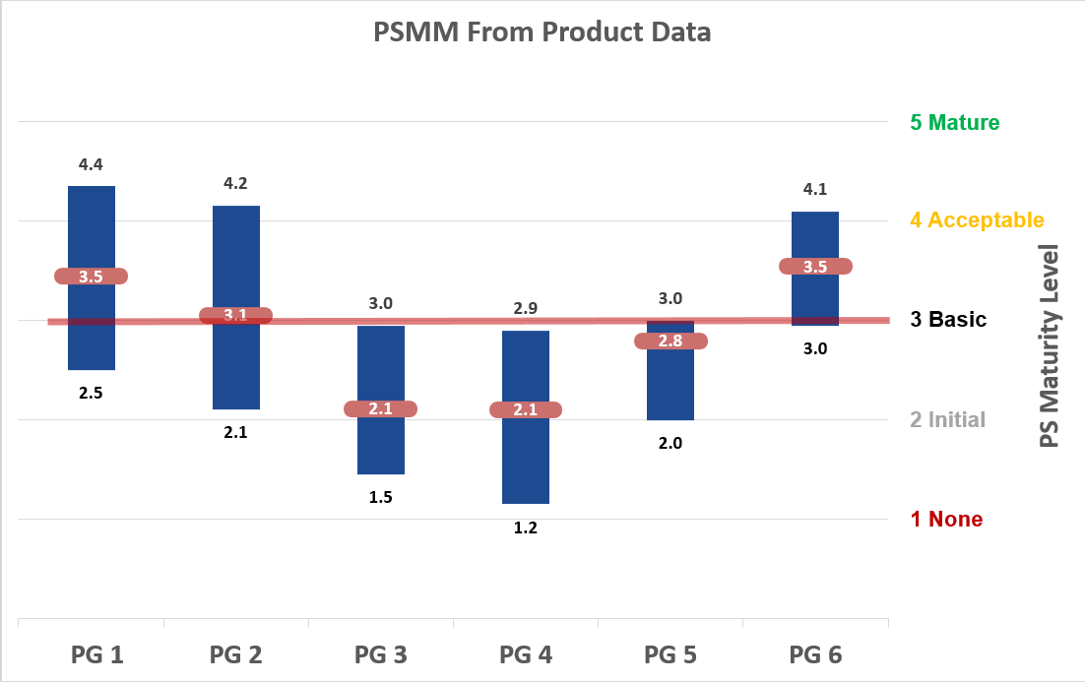
PSMM – State by Product Group / BU
Notes:
Product Security Maturity Model (PSMM) by LOB
Again, this metric indicates how well the LOBs are implementing the product security program.
Each Software Groups has multiple engineering team located in different development centers.
Some are more mature security-wise than others.
The data above is fictitious, of course. It was created using a stock chart in MS Excel.
We record the groups highest and lowest scores, along with the average.
Newly acquired companies tend to be lower on the scale.
PSCs peer review each other for self policing.
┘

Slide 11
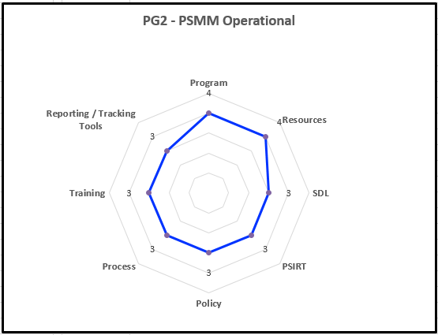
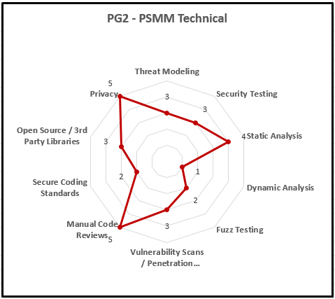
PSMM - Product / Product Group Spider Diagrams

Slide 12

PSMM Design Constraints
No budget for cool applications
  Use COTS tools
No budget for additional auditors
  Peer review
Be simple
  Automated, not weighted, minimal training and effort
Low overhead
  Minimal burden on engineering teams
Produce insightful metrics

Slide 13
PSMM Implementation Requirements
Provide a detailed MS Word doc fully listing requirements for each parameter level
  Include both Process and Quality of Execution
Map PSMM to other maturity models
Provide simple drop-down lists in MS Excel
Allow and adjust for “0 – Not Applicable”
Allow for phased roll-out, reporting at different org. levels

Slide 14
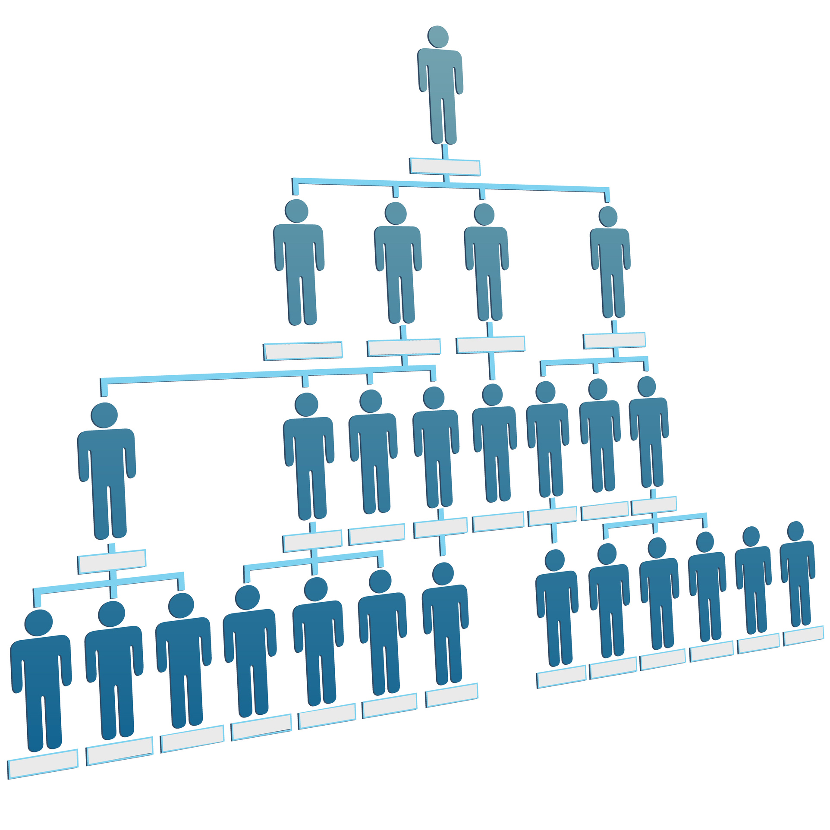
PSMM Data Collection Levels
PSMM Data Levels
  Entire Corp.
  All Corp. BUs
  Single Corp. BU
  All Product Groups in a single Corp. BU
  Single Product Group
  Single Product Line
  Agile Team (optional)
  Individual (training only)
Data can be collected at any and all levels; the lower the better
Data should be refreshed every 6 months

Slide 15
Organizational Structure – Who Collects the Data
Single Corp. BU
EVP & GM
VP
Sr. Director
Sr. Architect
SVP Engineering
VP Engineering
Architect
Sr. Engineer
QA Engineer
Product Quality Group
Product Security Group
Principle Product Security Architect
…
Sr. Product Security Architect
Engineering Product Development Group
…
Product Group #1
Product Group #n
PSC Lead
…
PSC Lead
…
PSC
PSC
…
PSE
PSE

Slide 16
Objectively Measuring PSMM Levels
Validation: How do we keep it honest? Peer Review
Individual PSCs score their own products
  If they do not know the answers then they should engage their product teams to get accurate answers
PSCs from one product group are assigned to review metrics from their peers in a different product group
PSC Leads score their entire product group from their perspective
PSC Leads review the scores of their product group’s PSCs and other product group leads to identify and correct gross inaccuracies
The Product Security and Privacy Governance Team performs rolling audits to ensure compliance, accuracy, and consistency

Slide 17
Simple Scoring
PSMM Level | Min. Score | Max. Score | Considered “In” Score
1-None | 20 | 39 | 20-29
2-Basic | 40 | 59 | 30-49
3-Initial | 60 | 79 | 50-69
4-Acceptable | 80 | 94 | 70-84
5-Mature | 95 | 100 | 85-100
Simple addition to compute scores (20 x 5 = 100)
Non-weighted
Operational, Technical, and Combined scores

Slide 18
Detailed MS Word Doc
5.4 Security Testing
This parameter measures how well software security requirements are being performed and verified by both engineering and QA.
Level 1 None
  No security plan. No security plan testing or validation performed.
Level 2 Initial
  Security plan created. Security plan testing and validation performed occasionally.
Level 3 Basic
  Security plan testing and validation performed completely at least once before release
  Functional Testing (what you know) performed to verify intended behavior
Level 4 Acceptable
  Security plan testing and validation performed completely several times before release
  Negative Space Testing (what hackers know) performed to identify non-intended behavior
Level 5 Mature
  Security plan testing and validation performed continuously and completely both before and after release
Process vs. Quality of Execution
⬆ ⬆
Compliant vs. Secure

Slide 19
Intel PSMM Level 4: Acceptable
Technical
Security Requirements Plan/DoD: Product teams conduct and report on required security tasks as defined in their security plan for their project milestones
Architecture and Design Reviews: Frequent architecture reviews are conducted
Threat Modeling: Trained security architects oversee frequent reviews accounting for all known attack vectors
Security Testing: Security testing performed completely several times
Static Analysis: Majority of products analyzed frequently, defect rate decreasing
Dynamic Analysis: Applicable products analyzed frequently, high and medium severity issues fixed. Defect rate near zero (0) in finished product.
Fuzz Testing: Scans run frequently, high and medium severity issues fixed, new custom scripts created
Penetration Testing: Resident pen testing expert available, defects in Bugzilla
Manual Code Reviews: Conducted on all potentially risky code using a shared tool
Secure Coding Standards: Following adopted standards
Open Source/3rd Party COTS Libraries: Fully maintaining all documented 3rd party libraries and versions shipped across all supported releases
Privacy: Privacy is integrated with product security

Slide 20
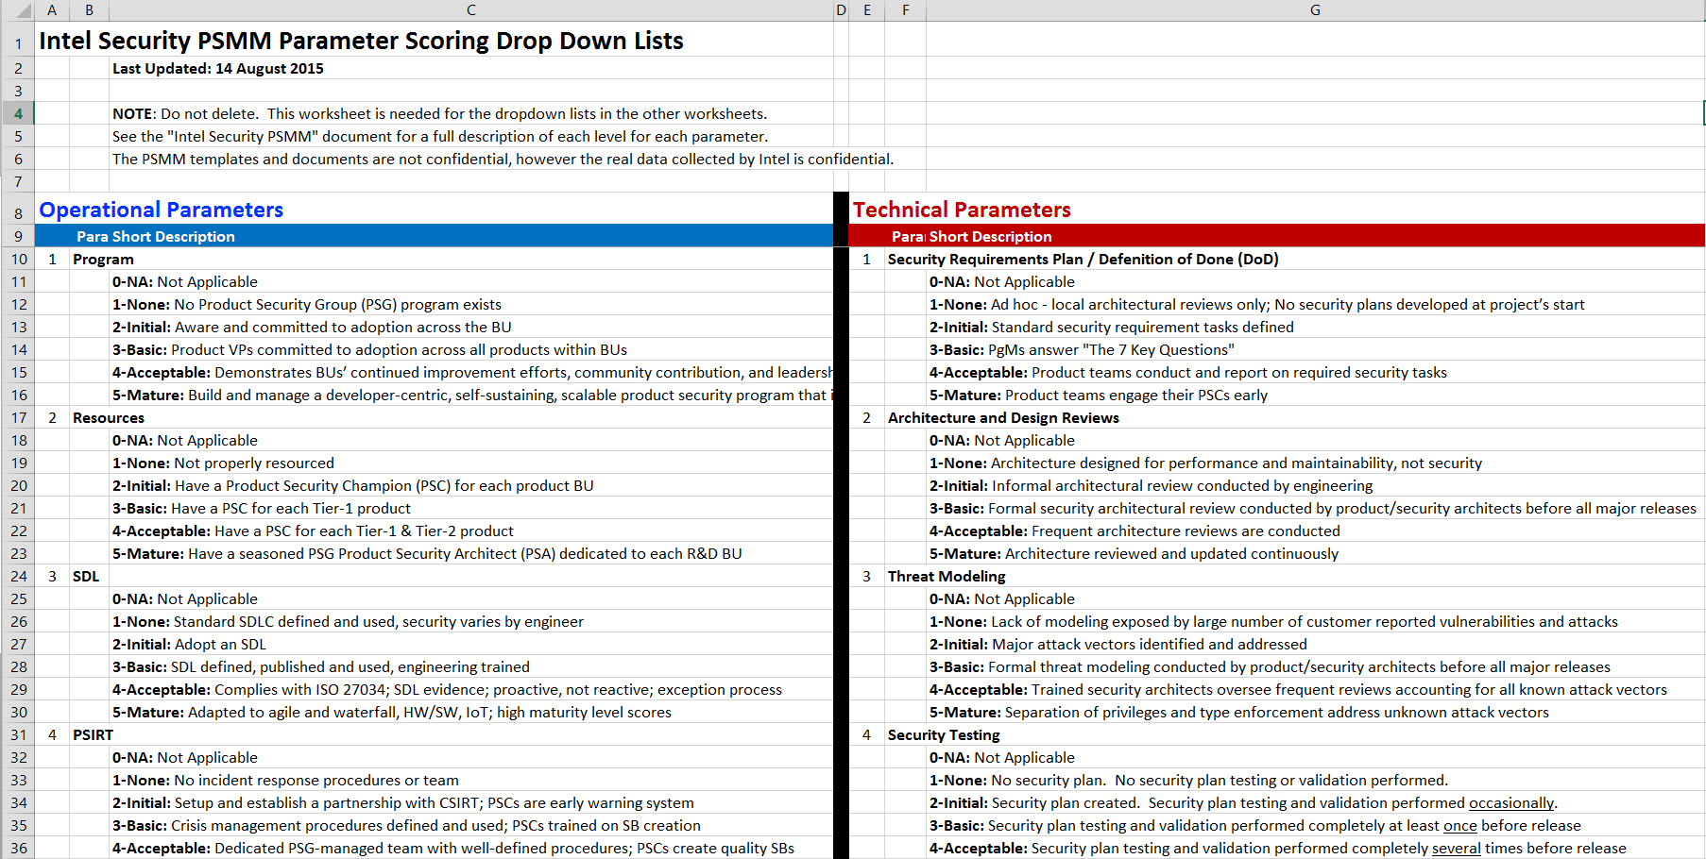
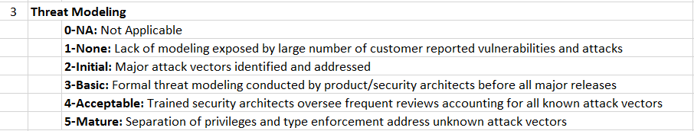
MS Excel Drop Down Lists

Slide 21
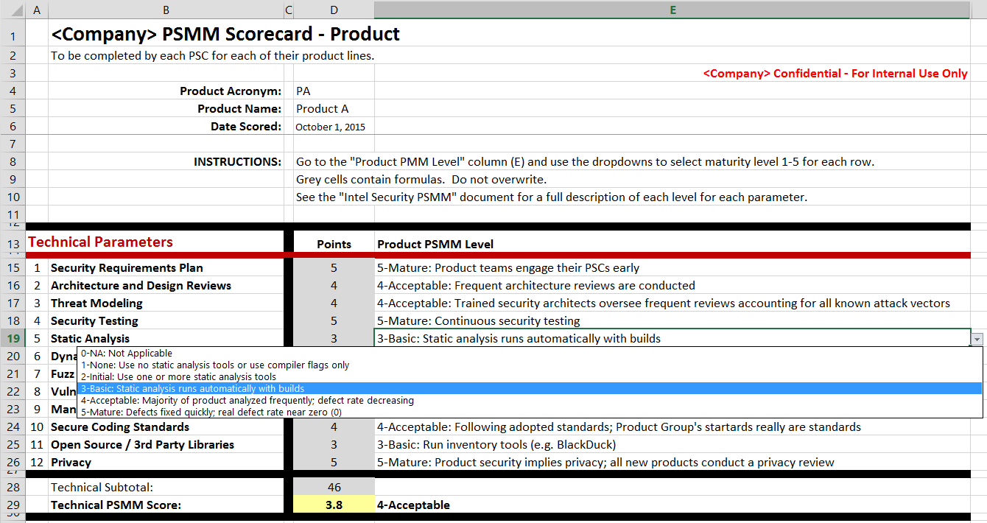
MS Excel Product Scorecard

Slide 22
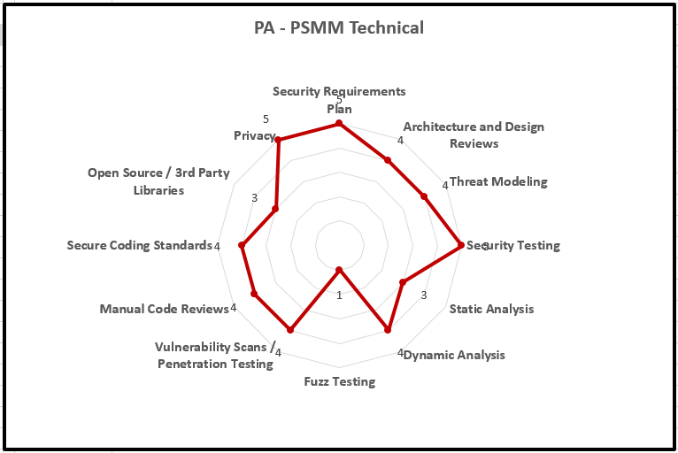
MS Excel Product Spider Diagram

Slide 23
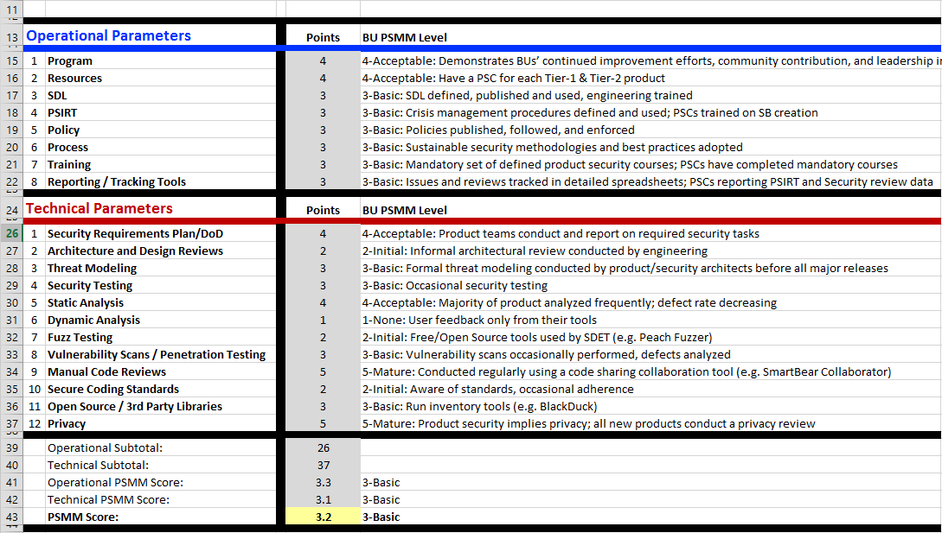
MS Excel Product Group Scorecard

Slide 24
MS Excel Product Group Spider Diagrams

Slide 25
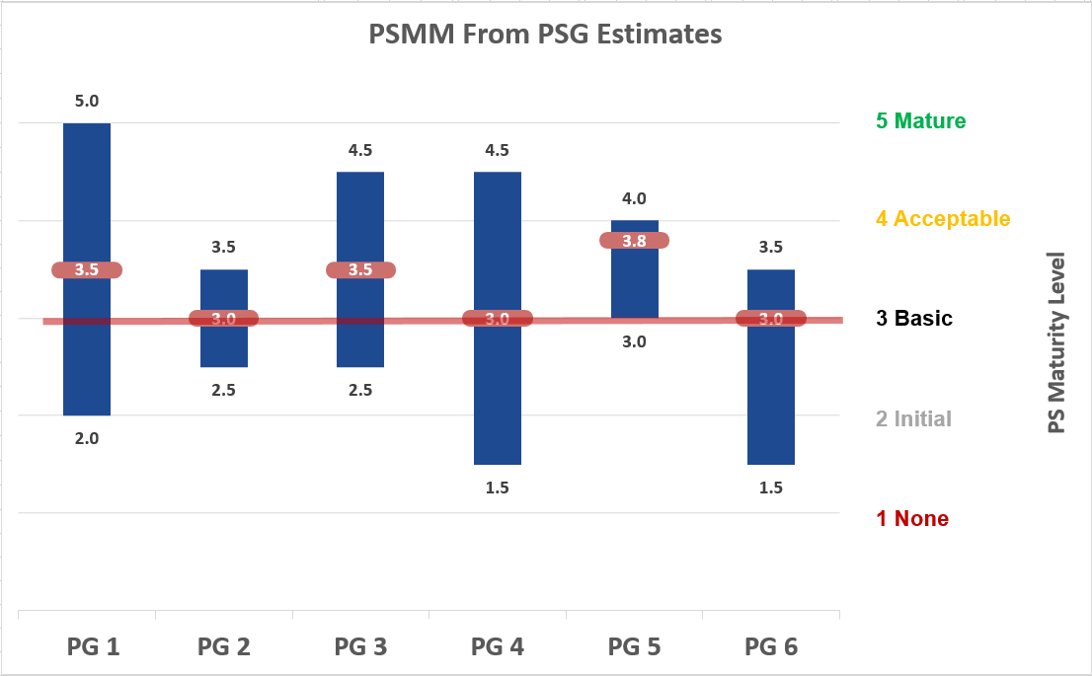
Least Accurate Metric – From PSG Estimates

Slide 26
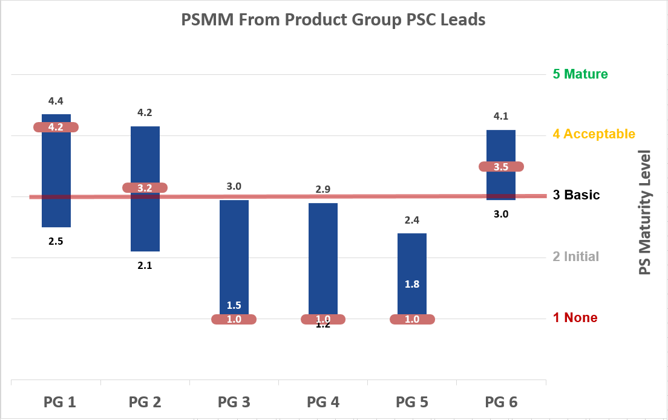
Somewhat Accurate Metric – From PSC Leads

Slide 27
Most Accurate Metric – From Product Data
Notes:
Product Security Maturity Model (PSMM) by LOB
Again, this metric indicates how well the LOBs are implementing the product security program.
Each Software Groups has multiple engineering team located in different development centers.
Some are more mature security-wise than others.
The data above is fictitious, of course. It was created using a stock chart in MS Excel.
We record the groups highest and lowest scores, along with the average.
Newly acquired companies tend to be lower on the scale.
PSCs peer review each other for self policing.
┘

Slide 28





PSMM – Operational
Continued improvement
2+ PSAs
Tier-2 PSCs
Extensive training library
Tool experts
Dedicated PSIRT
Single crisis
ISO 27034 compliance
Tracking DB w/dashboard
Developer-centric
Self-sustaining
Scalable
BU PSAs
Tier-3 PSCs
PSEs
Corp. SME training
Tools budget
Proactive PSIRT
Multiple crises
Agile + waterfall / HW + SW SDL
Tight corp. integration
Policy executive support
Metrics integrated into risk mgt. tools
Level of Maturity
X
SVP commitment
Tier-1 PSCs
Mandatory training
3+ tools integrated
PgM milestones
PSIRT defined
SDL used
Extended team
PSIRT XLS
Awareness
No budget
No reviews
Few tools
No PSIRT
Tribal knowledge
Email tracking
Plan created
BU PSCs
1+ tools
PSIRT is CSIRT
SDL adopted
PSMM Phase
None Initial Basic Acceptable Mature
Notes:
Like all maturity models, you go from low to high maturity based on your activities.
We have them defined in detail for our PSCs to ascertain what level their teams are operating at.
The Operational parameters are about the program as a whole.
┘

Slide 29
PSMM – Technical
Level of Maturity
Security reviews
All releases threat modeled
Defect rates decreasing
Fuzzing scripts written
Accept risks of 3rd party libs
Tight privacy partnership
Major releases threat modeled
All primary tools used
BlackDuck
Standards adopted
Privacy + security
Early reviews
Preventive measures modeling
Defect rates near 0
Best-in-class tools
Continuous security testing
All products pen tested
Open source SLAs
Standards adapted to environment
Tight privacy integration
Major attack vectors addressed
Freeware tools used
Standard awareness
Privacy team
X
Frequent attacks
No reviews
No constraints
PSMM Phase
None Initial Basic Acceptable Mature
Notes:
The Technical parameters are about how well the engineers are practicing secure principles and using their tools.
┘

Slide 30
Three Key Takeaways
1) PSMM: A simple and powerful way to measure the security maturity of your product security program and deliverables
2) Cost: Minimal budget, typically no additional resources needed, uses existing tools, minimal engineering overhead
3) Metrics: Product security metrics to drive towards Acceptable and Mature PSMM levels; focus on what matters per product line

Slide 31


Q&A
Harold Toomey
Sr. Product Security Architect
Product Security Group
Intel Security
Harold.A.Toomey@Intel.com
W: (972) 963-7754
M: (801) 830-9987

Slide 33

Backup Slides

Slide 34
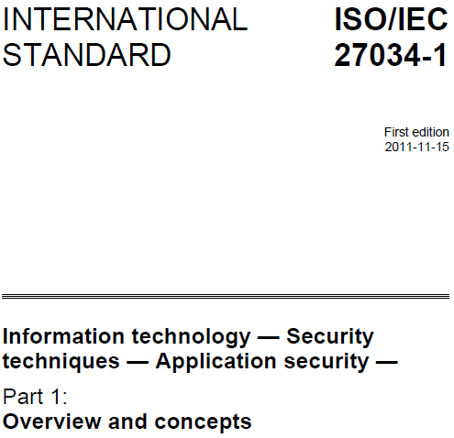
ISO 27034
ISO 27001/2: IT Security
ISO 27034: Application Security
  Part 1: Overview & concepts (Nov. 2011)
  Part 2: Organization normative framework (Aug. 2015)
  Part 3: Application security management process
  Part 4: Application security validation
  Part 5: Protocols and application security controls data structure
  Part 6: Security guidance for specific applications
Indicates what needs to be done
Process focused
Notes:
ISO/IEC 27034 is not:
•Development standard for software applications
•Application project management standard
•Software Development Lifecycle (SDLC) standard
ISO/IEC 27034 does not:
•Provide guidelines for physical and network security
•Provide controls or measurements (metrics)
•Provide secure coding strategies for any programming language

Slide 35



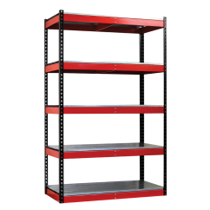


Agile SDLC
Design
Build
Verify
Requirements
RTW
Architecture
Backlog
PSI
Attack & Penetration Testing
Sprints
Hardening, Innovation, Planning
Evolving Architecture
Sprint 1 | … | Sprint n

Slide 36

Agile SDL Sprint
Iterative
Design
Functional Testing
Build
Dynamic Testing
Web
Vuln.
Static Analysis
Fuzzing
Secure Coding
Code Review
Sprint_{n}
Sprint Checkpoint

Slide 37
Agile SDL Activities
Plan of Intent:
Security activity mapping
Answer 7 key security questions
Initial privacy review initiated
Release Planning:
Security plan creation
Threat modeling
Security architecture review
Open source & 3rd party COTS whitelist
Initial privacy review completed
Post Release Sustainment:
PSIRT program
Security metrics
Sprint Planning:
Security plan execution
Iterative threat model updates
All security activities mapped in backlog
Security backlog prioritization
Static, dynamic & fuzzing activities
Security Definition of Done (DoD)
Black Duck Protex, license compliance
Development & Test:
Security plan executed
Security backlog verified
Static, dynamic & fuzzing executed
Sprint Review & Retrospective:
Iterative security plan completed
Security defects at “zero”
Security exceptions tracked
Open source & 3rd party COTS approved
PSI security metrics achieved
Security tools (tunes & optimized)
Release Launch Checkpoint:
Security plan archived
Security activities completed & reported on
Security Definition of Done (DoD) achieved
Threat model fully implemented
All security exceptions documented
Open source & 3rd party COTS exceptions
Final privacy review

Slide 38
Roles & Responsibilities
Role | Responsibilities
Sr. Director Product Security | Owns all product security within BU
Product Security Architect (PSA) | Mentor PSCs for threat modeling, security architecture reviews, security reviews, tools, PSIRT, training
PSC Product Group Lead | Over all Product Group PSCs and products w/out PSCs
Product Security Champion (PSC) | Collocated security engineer / architect POC for a product
Software / Security Architect | (See PSC)
Product Security Evangelist (PSE) | Collocated security QA POC for a product
Support Engineering Operations (SEO) | Tech Support champion for a product
Product Privacy Champion (PPC) | (See PSC)

Slide 39
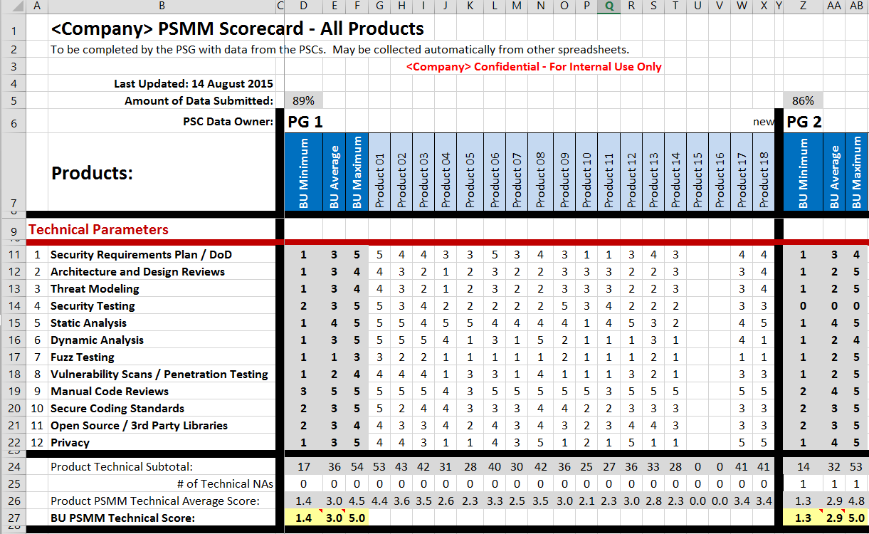
MS Excel All Product Groups Products Scorecard

Slide 40
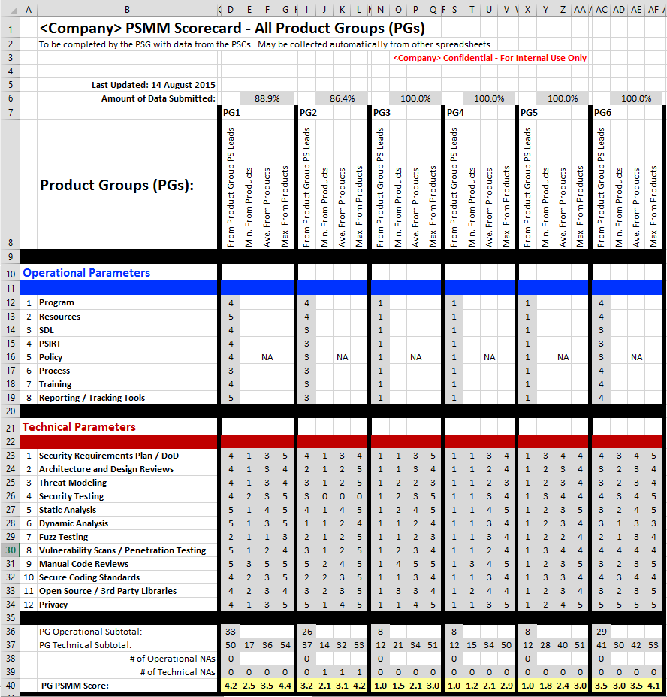
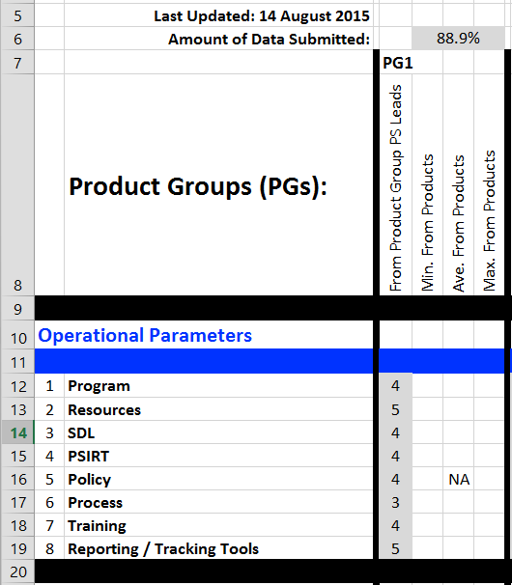
MS Excel All Product Groups

Slide 41
PSMM – % Overhead Costs
NOTE: High overhead % is bad
Overhead Costs $$
100%
Fire stomping mode
Hidden costs due to inefficiencies, disruptions, ad hoc responses
Mostly reactive
Refactoring
Program building
Balance of proactive & reactive
Some automation
~50%
50%
~40%
Mostly proactive
Some reactive
Efficient
Majority proactive
High automation efficiencies
~25%
X
~10%
~5%
0%
PSMM Phase
None Initial Basic Acceptable Mature
Notes:
http://commons.wikimedia.org/wiki/File:1_white,_green_rounded_rectangle.svg
None

