Slide 1
The Intel Security Group’s Agile SDL
Harold A. Toomey, PSG/ISecG
(harold.a.toomey@intel.com)
ISecG, Product Security Group
28 Jun 2016
1

Slide 2
Agenda
SDLCs / SDLs
Methodology Evolution
ISecG Agile SDL Activities
Activity Template Review
Overlap with Intel SDL
Overlap with SSG SSDF
Tracking SDL Activities
ISecG Product Security Maturity Model (PSMM)
Learning from our Experience

Slide 3
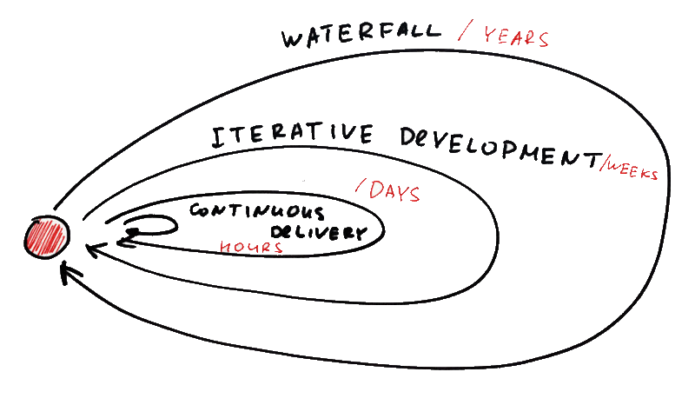
SDLCs / Security Development Lifecycles (SDLs)
Intel Public
Notes:
Waterfall
Primary methodology for hardware side of Intel
Was used by McAfee 5 years ago
Agile
Additional methodology used by the software side of Intel
>95% of Intel Security (McAfee) uses
Continuous Delivery
Fastest growing methodology for cloud technology
Where ISecG is currently headed

Slide 4



ISecG Methodology Timeline
10y 5y 4y Today
2006 2011 2012 2016
SDL SDLC
  Modified waterfall adopted
  (PLF)
  Began transition to agile (scrum)
  S-PLF introduced
  (Waterfall SDL)
  Completed transition to agile
  (Agile PLF)
  Defining continuous delivery (cloud)
  Refining agile SDL
  Defining cont. delivery
Notes:
10 years ago
Modified waterfall (PLF)
5 Years ago
Began mass transition to agile (scrum)
3 Years ago
Completed transition to agile
Today
Refining Agile SDL (90% complete)
Defining Continuous Delivery SDL

Slide 5
Intel Security Agile SDLC
Plan of
Intent
Program
Backlog
Release
Quality
Increment
(PSI)
Finished
Product
Team
Backlog
Stories
Daily
Scrum
Investment Themes,
Epics (Viability,
Feasibility, Desirability)
Release
Planning
Sprint
Planning
Development
& Test
Sprint
Review &
Retrospective
Release to
Customer
1-4 Weeks
Develop on a Cadence, Release on Demand
Plan-Of-Intent
Checkpoint
Release Planning
Checkpoint
Sprint Planning
Checkpoint
Sprint / Release Readiness Checkpoint
Release Launch
Checkpoint
Post Release
Sustainment
Intel Public

Slide 6

Big Question
The waterfall methodology clearly defines when each SDL activity is performed
Q: When/where do you do all of the SDL activities in agile?
  A: Typically as user stories in 2 week sprints
Q: What about continuous delivery to the cloud?
  A: Perform as many SDL activities continuously and automatically as possible.
  For the others, set time-based triggers such as “If no <SDL Activity> in past 6 months, then…”
Intel Public

Slide 7

Agile SDL Sprint
Iterative
Design
Functional Testing
Build
Dynamic Testing
Web
Vuln.
Static Analysis
Secure Coding
Fuzzing
Code Review
Sprint

Slide 8



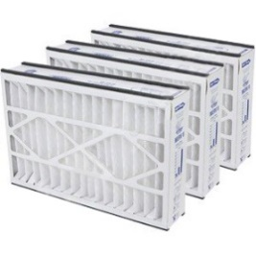
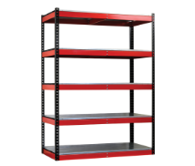

Train Headlights vs. Final Destination
Design
Build
Verify
Requirements
RTW
Architecture
Backlog
PSI
Attack & Penetration Testing
Sprints
Hardening, Innovation, Planning
Evolving Architecture
Sprint 1 | … | Sprint n

Slide 9
ISecG Agile SDL Activities
T01 - Security Requirements Plan / Definition of Done (Agile)
T02 - Security Architecture Reviews
T03 - Security Design Reviews
T04 - Threat Modeling
T05 - Security Testing
T06 - Static Analysis
T07 - Dynamic Analysis
T08 - Fuzz Testing
T09 - Vulnerability Scans
T10 - Penetration Testing
T11 - Manual Code Reviews
T12 - Secure Coding Standards
T13 - Open Source
T14 - 3rd Party COTS Libraries
T15 - Privacy
Red = Always Mandatory
Black = Conditionally Required

Slide 10
ISecG Agile SDL Activities

Slide 11
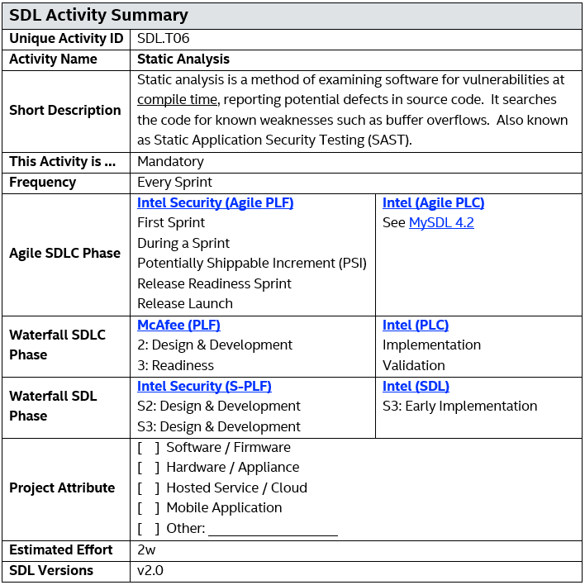
ISecG Agile SDL Activity Template
Intel Public

Slide 12
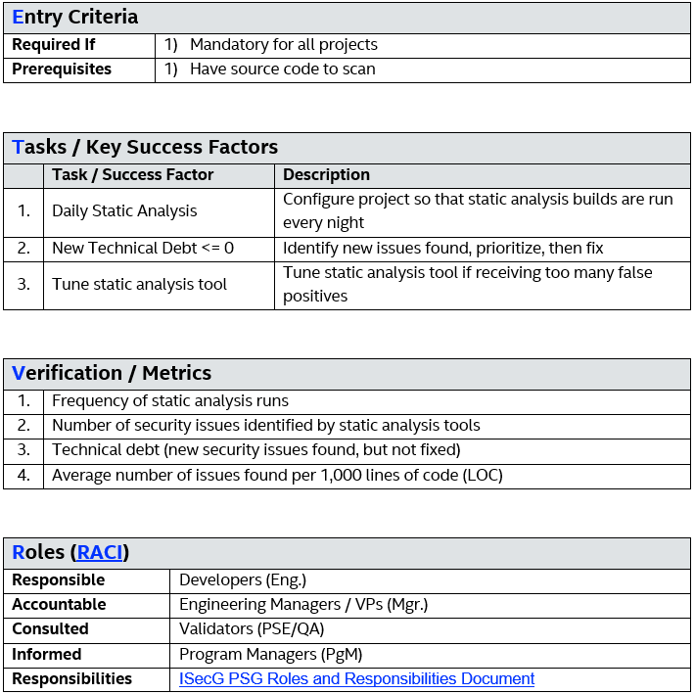
Entry Criteria
Intel Public

Slide 13
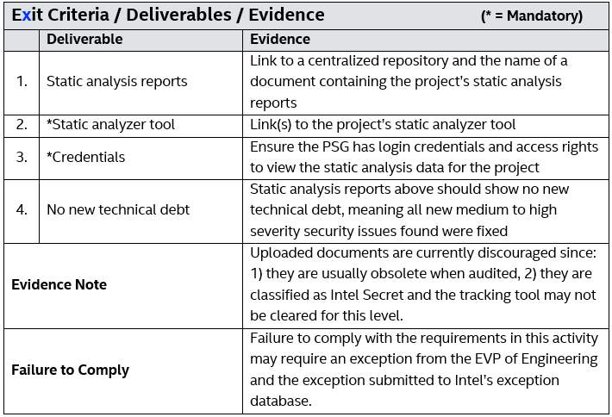
Exit Criteria
Intel Public

Slide 14
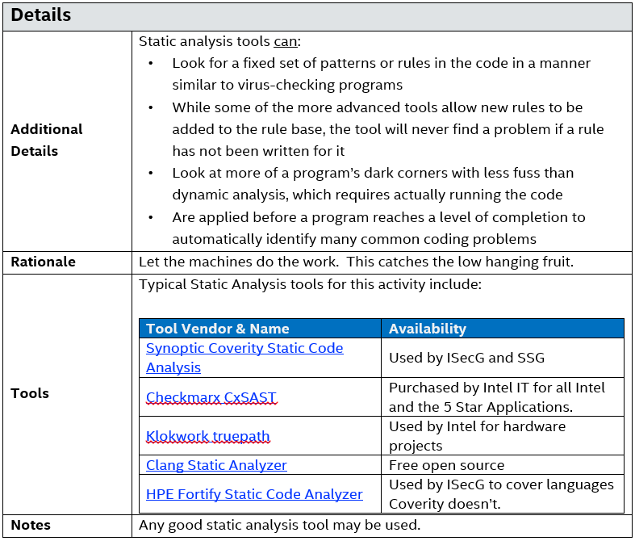
Details & Tools
Intel Public

Slide 15
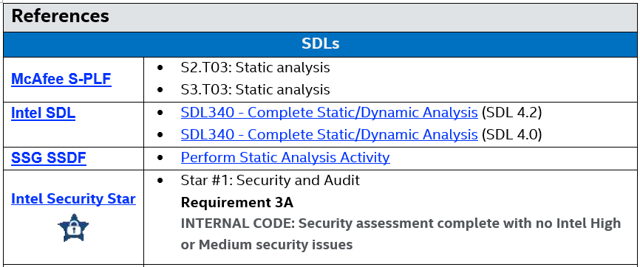
SDL Mappings
MySDL and the SSDF compliment the Agile SDL
Links to both are provided for all 15+ SDL activities
Engineers are encouraged to use Intel BKMs
Intel Public

Slide 16
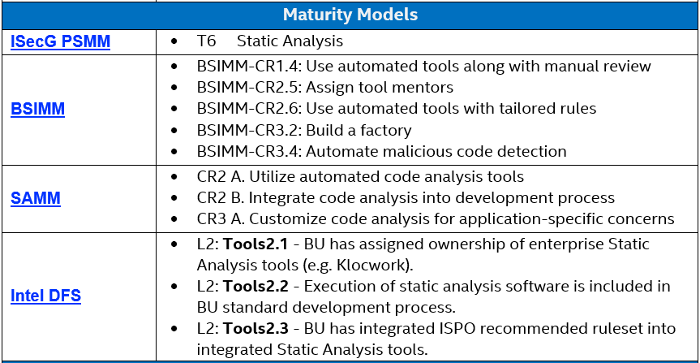
Maturity Model Mappings
Intel Public

Slide 17
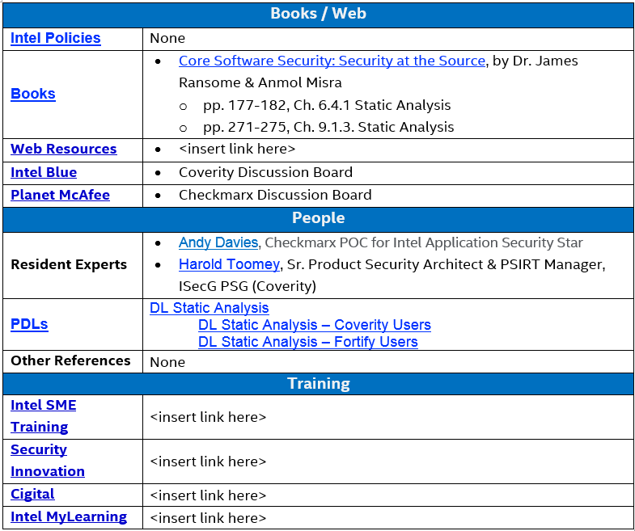
Books, People, and Training
Intel Public

Slide 18
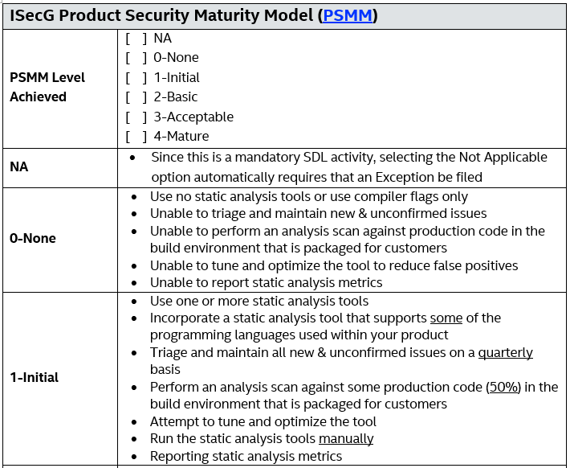
PSMM Scoring upon Completion
Intel Public

Slide 19
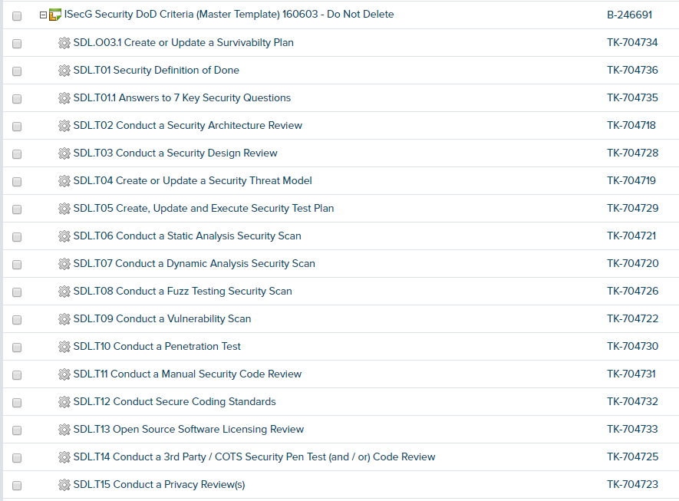

Agile SDL Story Template in Version One
Intel Public

Slide 20
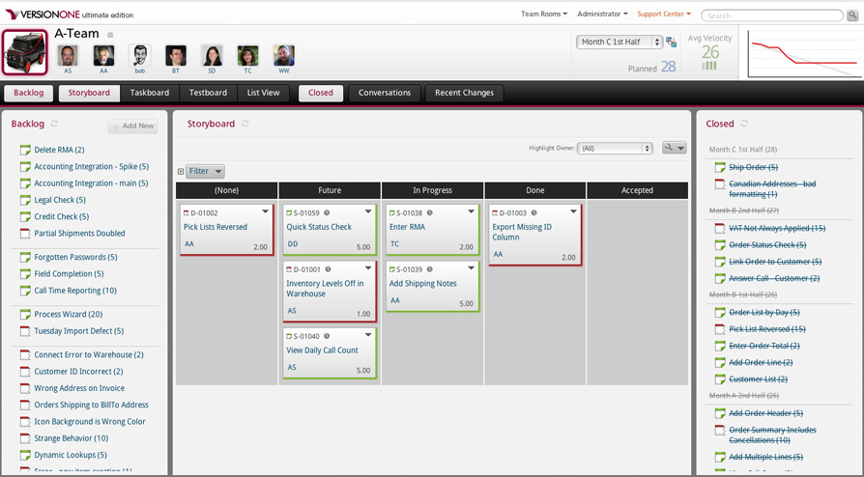
Version One Agile SDL DoD Story Board
SDL activities are advanced by the PSC on the Storyboard per product release
  None → Future → In Progress → Done → Accepted
Intel Public
Notes:
This is an example slide of VersionOne and the progressive path to completion for each of the SDL activities the PSC is working on.
As each Sprint begins, they move the activities from “left to right” and once the test & tasks for each story is completed.
The “artifacts” are then attached to the Story level to show it meets all criteria needed to be listed as Complete or Accepted and Closed at the end of Sprint.
This is where we need to make sure all SDL activities identified for a release “Must be completed” otherwise it will require a Security Exception to be created.

Slide 21
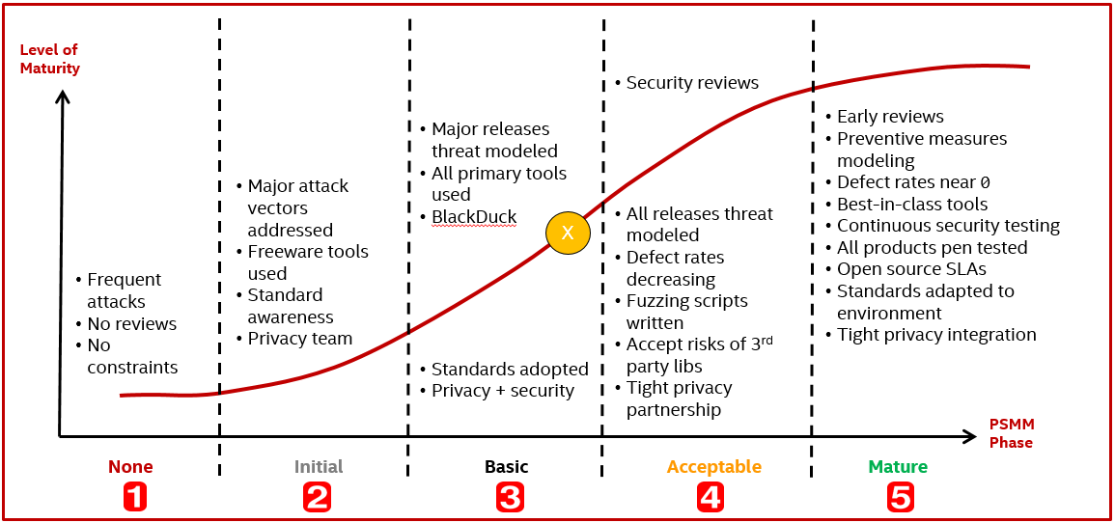
The ISecG
Product Security Maturity Model (PSMM)
SDL-Gov audits measure the minimum (yes, no)
PSMM measures how well (good, better, best)
  Covers both operational and technical parameters
  Provides a simple, powerful, low cost, low overhead, metric used by ISecG and other Intel BUs
Maturity levels
    0. None
    1. Basic
    2. Initial
    3. Acceptable
    4. Mature

Slide 22

ISecG PSMM Parameters
Operational Technical
Program
SDL
PSIRT
Tools
Resources
Policy
Process
Training
Metrics
Tracking Database
Security Requirements Plan / DoD
Security Architecture Reviews
Security Design Reviews
Threat Modeling
Security Testing
Static Analysis
Dynamic Analysis
Fuzz Testing
Vulnerability Scans
Penetration Testing
Manual Code Reviews
Secure Coding Standards
Open Source
3rd Party COTS Libraries
Privacy
$$(10+15)×4=100$$

Slide 23
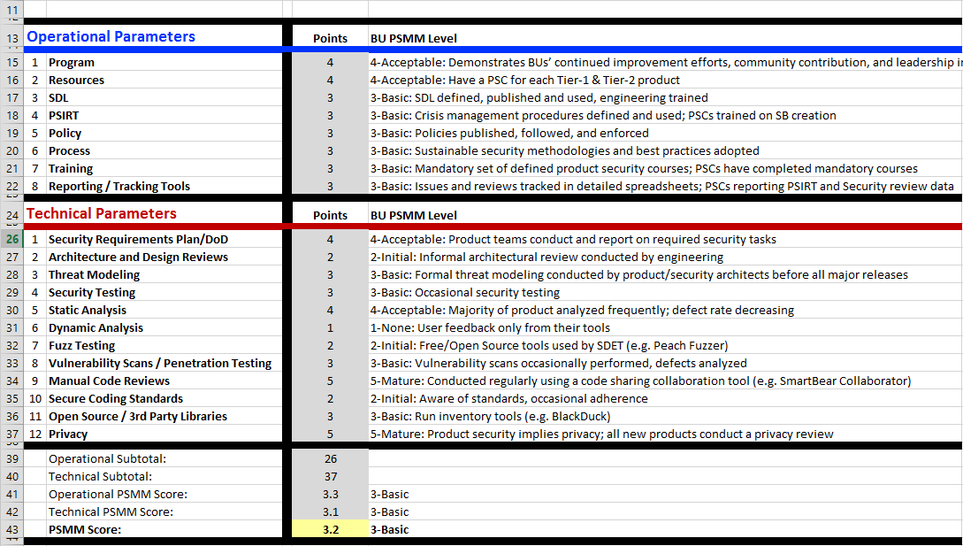
Scoring the PSMM

Slide 24
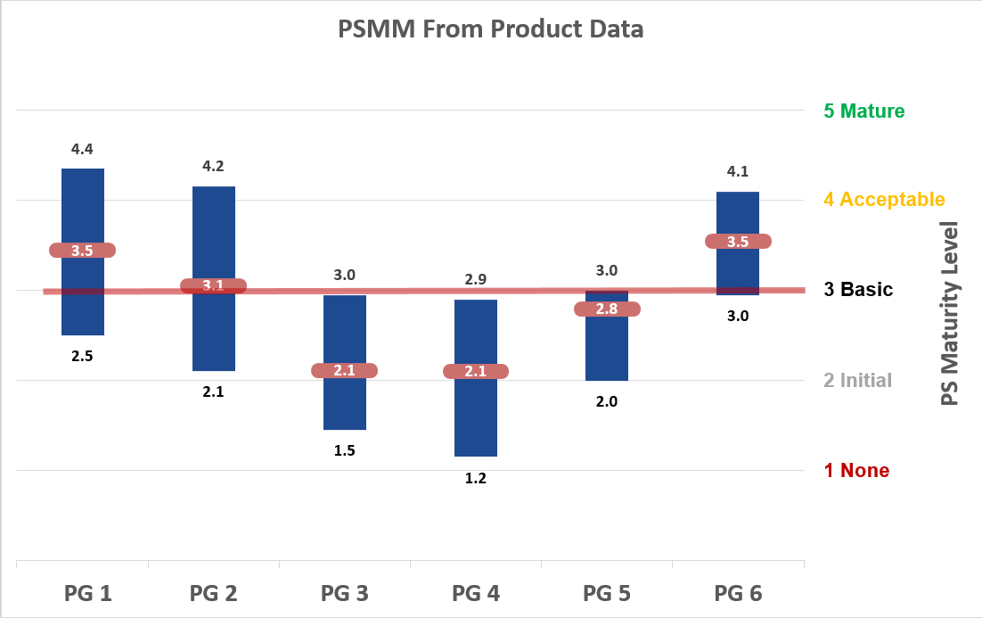
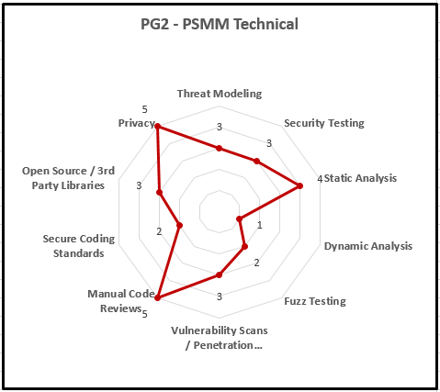
Metrics - PSMM Data by Product Group
Intel Public

Slide 25

Learning from Our Experience - People
Identify the experts
  No one person can do it all
Trust the Product Security Champions (PSCs)
  They are smart and want to do what is right
  They balance security with their time, expertise, resources and schedule
Collaborate often
  Meet as PSCs weekly (business and technical)
  Use email PDLs
Don’t just train…mentor!
  Have an open door policy and help them to mature and grow
Intel Public

Slide 26
Learning from Our Experience - Process
Keep it flexible
  Don’t micro manage
  Don’t default to “all activities are mandatory”
We don’t need to write a 200 page book on each SDL activity
  Instead point engineers to the best material & BKMs
Some Intel requirements are simply mandatory
  Filing exceptions for incomplete SDL activities or shipping with high vulns.
  Intel blacklist for 3rd party components
  Intel Security and Privacy Governance (SDL-Gov) audits
The ISecG PSMM and Agile SDL go hand-in-hand
Intel Public

Slide 27
Learning from Our Experience - Tech
  Purchase tools as one Intel
  Volume discounts, flexible license terms
  Human vs. Machine
  Some activities require much more human interaction than others
  Where possible, automate: “Make the computer do the work”
  Automation is required for successful continuous delivery
Bring the tools to the engineers
  Version One / Jira vs. SharePoint
  Provide customized templates and real-world examples
Good tools can minimize exceptions
  It is hard to do fuzz testing without an easy to use tool with good content
Intel Public

Slide 28

Suggest Improvements
SDLs are constantly evolving
  Waterfall → Agile → Continuous Delivery → IoT
Feel free to use our Agile SDL material
  http://goto/ISecGPSG >> Process: Agile SDL
  Feel free to improve our Agile SDL and PSMM material
  Contact the ISecG Product Security Group (PSG) with your suggestions
  PDL: “ISecG PSG”
  harold.a.toomey@intel.com
Intel Public

Slide 29


Slide 30
Legal Disclaimer
INFORMATION IN THIS DOCUMENT IS PROVIDED “AS IS”. NO LICENSE, EXPRESS OR IMPLIED, BY ESTOPPEL OR OTHERWISE, TO ANY INTELLECTUAL PROPERTY RIGHTS IS GRANTED BY THIS DOCUMENT. INTEL ASSUMES NO LIABILITY WHATSOEVER AND INTEL DISCLAIMS ANY EXPRESS OR IMPLIED WARRANTY, RELATING TO THIS INFORMATION INCLUDING LIABILITY OR WARRANTIES RELATING TO FITNESS FOR A PARTICULAR PURPOSE, MERCHANTABILITY, OR INFRINGEMENT OF ANY PATENT, COPYRIGHT OR OTHER INTELLECTUAL PROPERTY RIGHT.
Performance tests and ratings are measured using specific computer systems and/or components and reflect the approximate performance of Intel products as measured by those tests. Any difference in system hardware or software design or configuration may affect actual performance. Buyers should consult other sources of information to evaluate the performance of systems or components they are considering purchasing. For more information on performance tests and on the performance of Intel products, reference www.intel.com/software/products.
Intel and the Intel logo are trademarks of Intel Corporation in the U.S. and other countries.
*Other names and brands may be claimed as the property of others.
Copyright © 2016. Intel Corporation.
http://intel.com/software/products

