Slide 1
A Proposed New Standard: Common Privacy
Vulnerability Scoring System (CPVSS)
Jonathan Fox, Privacy Office/PDIT
Harold A. Toomey, PSG/ISecG
Jason M. Fung, SeCoE/PEG
Sumanth Naropanth, NDG

Slide 2
Agenda
Introduction
What is CPVSS?
Why is the CPVSS important?
CPVSS Overview
Example Incident
Example Incident Scored with CVSS
What would be the Base CPVSS score for the example?
Lessons Learned

Slide 3
Introduction
There is an industry standard called Common Vulnerability Scoring Systems (CVSS) to score the severity of vulnerabilities in products
There is no standard for scoring the severity of privacy issues created by security vulnerabilities
Common Privacy Vulnerabilities Scoring System (CPVSS) is a newly proposed standard to address this gap

Slide 4
What is CPVSS?
  The CPVSS (based on CVSS) rates privacy vulnerabilities (or incidents) occurring as a result of security vulnerabilities based on a diverse set of factors, such as:
    Sensitivity
    Exploitability
    Impact
    Scope
    Redemption level
    Report confidence
    Environment

Slide 5
Why is the CPVSS important?
Not all privacy risks due to security vulnerabilities are equal or warrant the same level of attention
  Not every nail needs a sledge hammer
  Privacy issues are increasingly receiving executive management focus and attention
    Product Incident Response teams need to have a pragmatic methodology to rate and report privacy risk and remediation efforts
  The same methodology can be used by product development team to prioritize privacy issues identified during product development lifecycle
    Consistency support efficiency

Slide 6
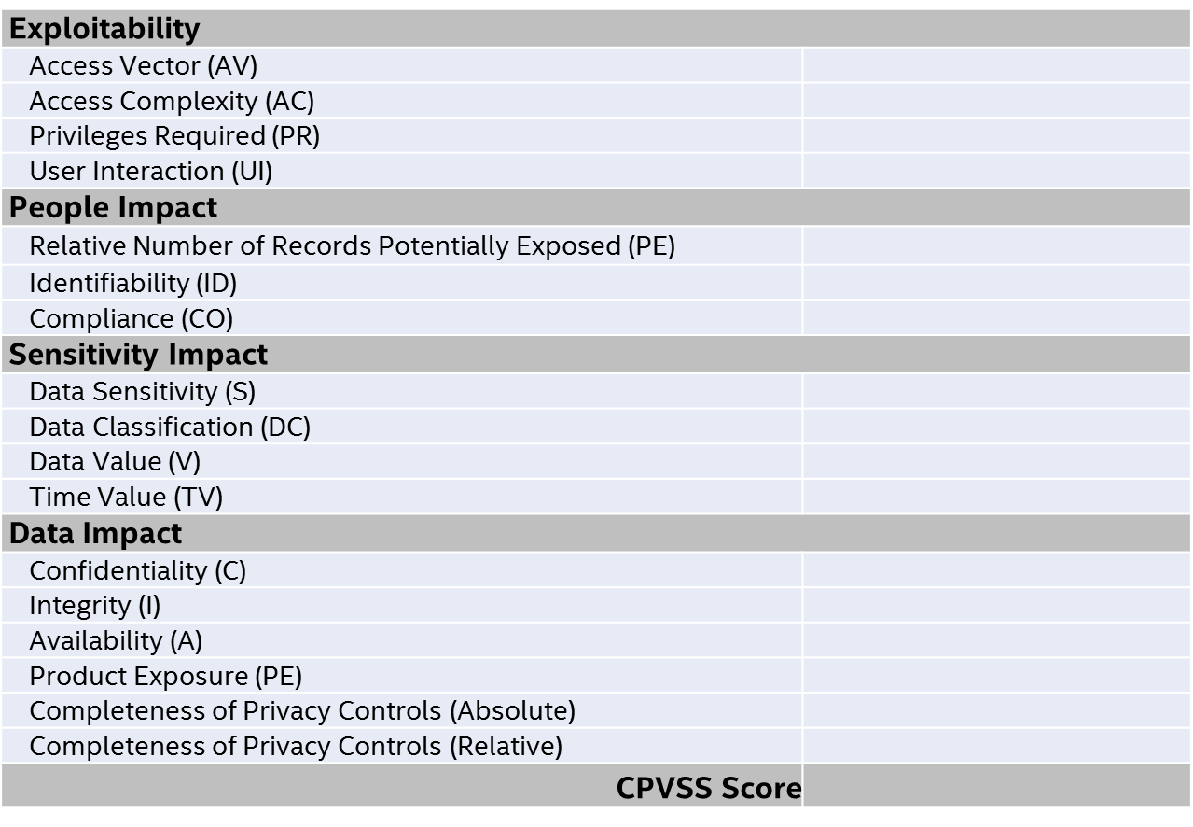
CPVSS Overview

Slide 7
Example Incident
A cross site scripting vulnerability was reported in a wearable product:
  This vulnerability could be leveraged via an exploit to get complete read and write access to a victim user’s cloud account including user profile details (full name, postal address, email), social circles (friends’ names, social comments), activity information, GPS data and device details.
  The victim only receives an innocuous looking “Friend Request”.
  The exploit is run as soon as the victim logs in to his cloud account using a web browser. The vulnerability could easily be used to target specific individuals (similar to spear-phishing attacks) to gain access to their personal information without requiring any user interaction.
  If the vulnerability is exploited publicly, the loss of user data would have qualified as a privacy incident due to the nature of the data present in the cloud based accounts.

Slide 8
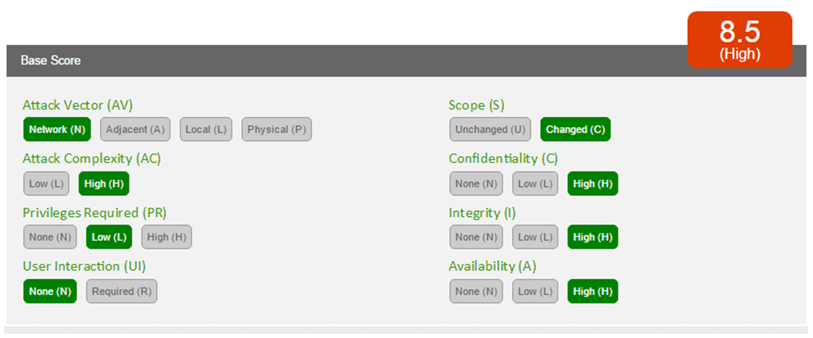
Example Incident Scored with CVSS

Slide 9
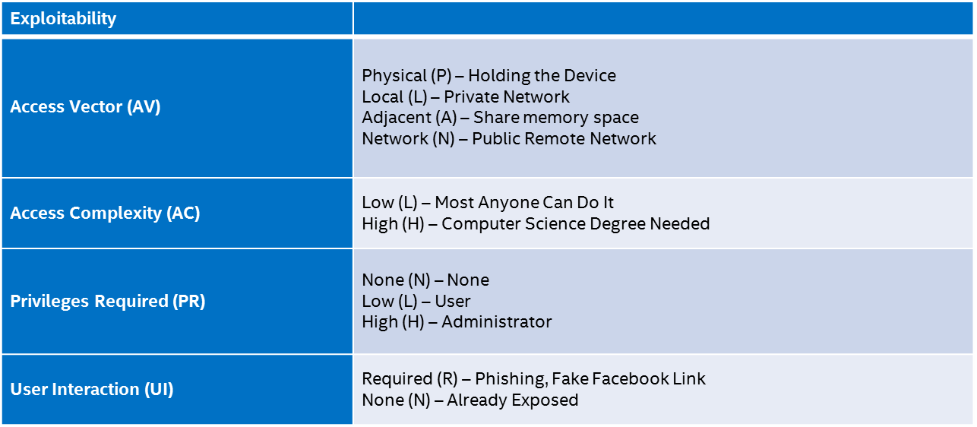
What would be the Base CPVSS score for the example?

Slide 10
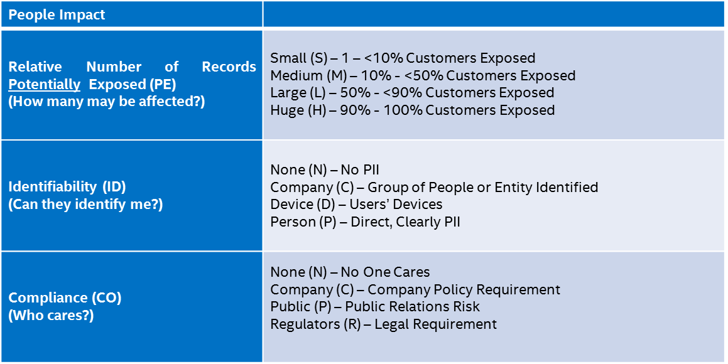
What would be the Base CPVSS score for the example?

Slide 11
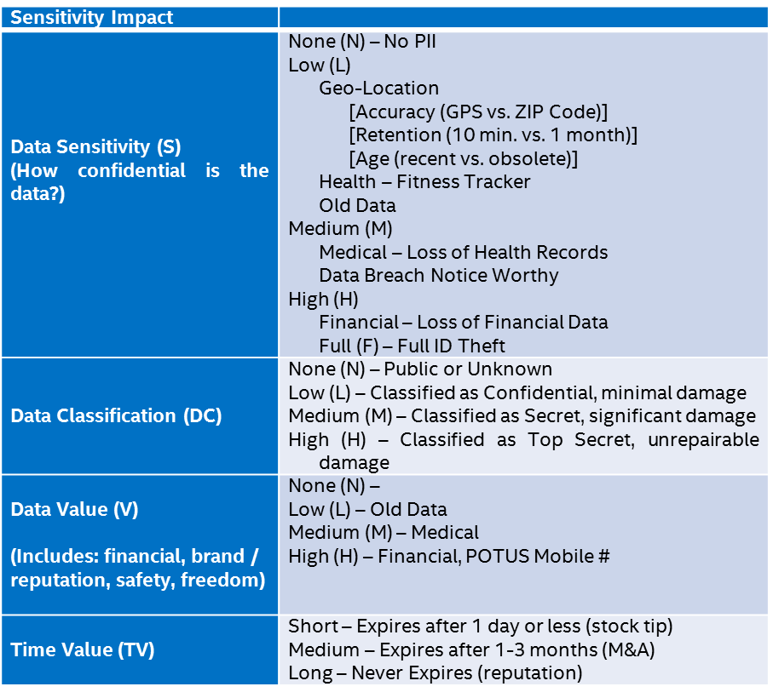
What would be the Base CPVSS score for the example?

Slide 12
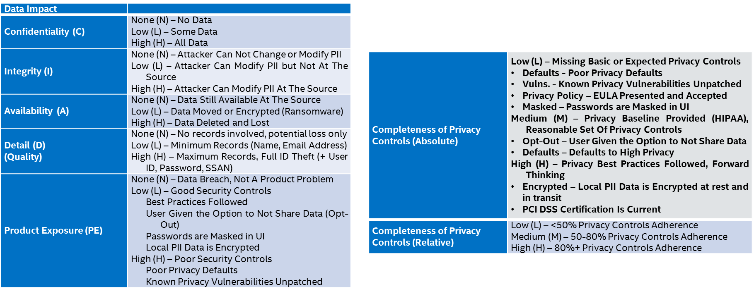
What would be the Base CPVSS score for the example?

Slide 13
Lessons Learned
Privacy vulnerabilities introduced or caused by security vulnerabilities can be calibrated, measured, and prioritized in a logical and objective way
This will support efficient and effective disposition and remediation efforts
There is overlap between how security and privacy identify and view risk
There are also critical aspects of privacy risk that are missed if the viewfinder just focuses on security measurements and calibrations
Informal external exposure of CPVSS has been very positive with the recurring statement that something like this is really needed by the industry
We plan to preview CPVSS more broadly within Intel to solicit inputs, and then introduce it to Mitre CVSS SIG

Slide 14
Interested in helping with the creation of the CPVSS?
  Contact one of us:
    Jonathan.Fox@Intel.com
    Harold.A.Toomey@Intel.com
    Jason.M.Fung@Intel.com
    Sumanth.Naropanth@Intel.com

Slide 15
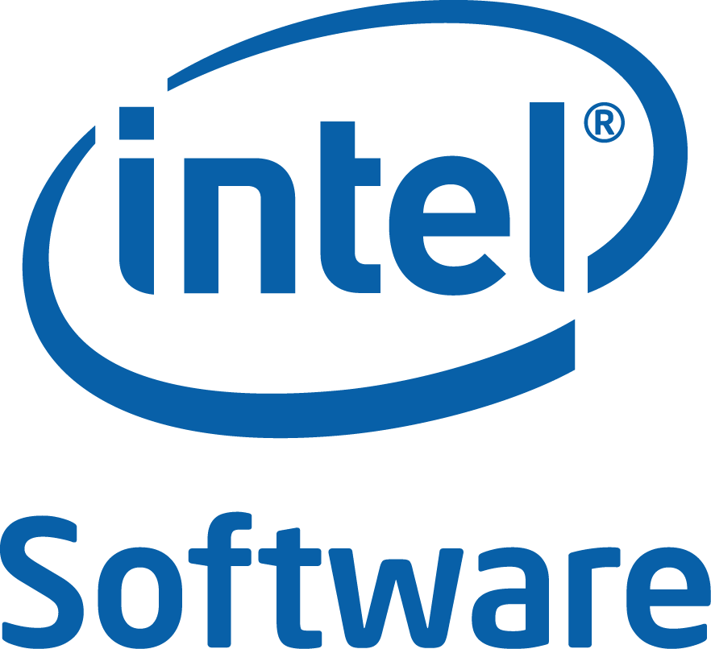

Slide 16
Legal Disclaimer
INFORMATION IN THIS DOCUMENT IS PROVIDED “AS IS”. NO LICENSE, EXPRESS OR IMPLIED, BY ESTOPPEL OR OTHERWISE, TO ANY INTELLECTUAL PROPERTY RIGHTS IS GRANTED BY THIS DOCUMENT. INTEL ASSUMES NO LIABILITY WHATSOEVER AND INTEL DISCLAIMS ANY EXPRESS OR IMPLIED WARRANTY, RELATING TO THIS INFORMATION INCLUDING LIABILITY OR WARRANTIES RELATING TO FITNESS FOR A PARTICULAR PURPOSE, MERCHANTABILITY, OR INFRINGEMENT OF ANY PATENT, COPYRIGHT OR OTHER INTELLECTUAL PROPERTY RIGHT.
Performance tests and ratings are measured using specific computer systems and/or components and reflect the approximate performance of Intel products as measured by those tests. Any difference in system hardware or software design or configuration may affect actual performance. Buyers should consult other sources of information to evaluate the performance of systems or components they are considering purchasing. For more information on performance tests and on the performance of Intel products, reference www.intel.com/software/products.
Intel and the Intel logo are trademarks of Intel Corporation in the U.S. and other countries.
*Other names and brands may be claimed as the property of others.
Copyright © 2015. Intel Corporation.
http://intel.com/software/products

